Slide 1
Technology tools for the Tech “Un” Enabled Teacher and Classroom
Mrs. LaRita Wiggins and Mrs. Karen Lewis
Henry County Technology Conference
July 22, 2015

Slide 2
Competencies for this session: I can engage students using technology. I can use technology to work efficiently . I can integrate technology in my class even if I have limited resources.
So, what is a technology “un” enabled
teacher or classroom?

Slide 3
You Might be a tech “un” enabled Teacher if…..
You still have to buy chalk for your classroom.
Your classroom T.V. can not be used because it won’t work with digital cable.
Your phone flips open
You still ask for directions
You get on a plane and ask what the in flight movie will be
You still use your house phone to call people to tell them about your day.
You still buy workbooks
You question why you did not get credit for technology use on your TKES evaluation when you used the overhead projector

Slide 4
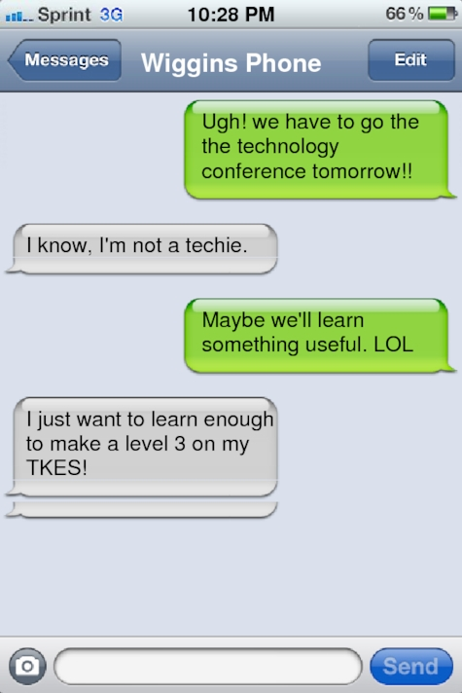
www.ifaketext.com
Instructional Strategy: Discussion, explain a math problem, foreign language conversation, character conversations
Student Engagement: Introduce a lesson or warm-up
Assessment Strategy: Ticket out the door
Tools needed: Student provided devices or computers or LCD projector and one computer

Slide 5
TKES Evaluation Standards (We will provide tools that will help you score at levels 3 or 4 if used consistently in your classroom)
Standard 1: Professional Knowledge
Standard 2: Instructional Planning
Standard 3: Instructional Strategies
Standard 4: Differentiated Instruction
Standard 5: Assessment Strategies
Standard 6: Assessment Uses
Standard 7: Positive Learning Environment
Standard 8: Academically Challenging Learning
Standard 9: Professionalism
Standard 10: Communication

Slide 6
www.TodaysMeet.com
Back Channel for today’s lesson
Used to pose questions, share ideas make comments
Online “parking lot”
Digital record of learning
Extend the learning session
Tools needed: LCD and projector and/or student devices
https://todaysmeet.com/AwesomeSession

Slide 7
Plan your work, then work your plan!
www.pinterest.com
Ideas, ideas, ideas
Online file cabinet
Visual representation
Follow us! LaRita Wiggins and Karen Lewis
www.Teacherspayteachers.com
Find lessons and resources for instruction
Don’t reinvent the wheel
Lots of Free materials

Slide 8
https://www.plickers.com/
Essential Question:
How do I assess my students and utilize technology?
How do get at least a level three utilizing technology on TKES?

Slide 9
Assess student learning
Decide what you want to assess: It could be used as a ticket out the door, openings, or pre-assessments.
Download the Plickers app from Google Play or Itunes.
You must enter your assessments on your phone/computer.
Your assessment should not be more than five questions.

Slide 10
Preparing in advance makes everything easier at the end of the school year.
Print out the Plicker cards for your students.
Warning – DO NOT LAMINATE CARDS
Create your classes – it’s really not that hard!
(Class creation example by Ms. Lewis)

Slide 11
Accessing and Archiving Reports
Just a click of the button!
Tools needed: LCD Projector and 1 computer.

Slide 12
Communicate, Communicate, Communicate
www.classdojo.com
Classroom Management
Random name caller
Daily email to parents
MTSS Intervention
Email reminders
Visual representation of behavior
Data tracking
www.remind101.com
Send text reminders about your class to parents and students.

Slide 13
www.TodaysMeet.com
Checking the “parking lot” for questions
Post one idea you can try the first week of school
Share how you will use one of the tools discussed so far in this AWESOME session!
https://todaysmeet.com/AwesomeSession

Slide 14
www.edpuzzle.com Make any video your lesson!
Flipped classroom resource
Choose a video based on content needs
Edit the video
Insert your voice over the video
Insert questions (quizzes) any place in the video
Make your own class on Edpuzzle
View the tutorials and play (Genius minutes!)

Slide 15
Competencies for this session: I can engage students using technology. I can use technology to work efficiently . I can integrate technology in my class even if I have limited resources.
Do you have the tools you need to achieve these competencies?

Slide 16
This presentation can be accessed on Mrs. Wiggins’ school web page @ Austin Road Middle
http://schoolwires.henry.k12.ga.us/Page/63713
We hope you enjoyed our
AWESOME Session!

